Slide 1

Event Master Plugin for Stream Deck
v3.1.x
Requires Event Master version 9.2 or greater
Requires Streamdeck version 4.1 or greater
Notes:
Starting point: Image Processing @Barco and our portfolio
Explaining live presentation switching vs. large video wall control vs. signal distribution, … in order to position Event Master vs. Virtual Matrix vs. Transform N vs….
This section I will make a first draft, that I’ll share later this week
Event Master – Designed for Live Presentation switching
A) Product family overview
The different products in the family
The high-level value prop: your slide 20
B) Key application areas and USPs
Even though the use cases/USPs are often the same, I would have 1 slide to recap difference between ‘live presentation switching’ and ‘large video wall processing:
Large video displays:… Manage video across multi-display (multi LCD panels, multi LED processors, projection blends) with composition, flexible layouts, excellent quality
Live presentation switching: …Deliver presentations flawless: many sources, many displays, full control, 100% reliability (with often a large video wall involved)
I would combine your “When you need…” with the application examples. Now you list all the “when you need …”, and then afterwards you give application examples. It will be stronger / clearer when combined:
E.g., “When you need 4:4:4 12 bit processing”
First slide: the explanation / value (your slide 5)
Immediately after: one or more application examples where you need 444 12 bit, with the diagram (e.g. like slide 13)
...done for each of the key use cases (when you need…)
C) Configurator options
Your slide 21-27 as intro
But then followed by a few examples like we built the ‘leaflet’ that Hans is now optimizing for graphics. These are the kind of things you want to highlight here to make them understand what drives the configuration/price
Linking possibilities & use cases
D) User control / User interface
Your section slide 28-32
D) Sales/Partner enablement
How to use configurator?
How to build quotes?
How to demo?
Training videos
Large video wall control: Event Master vs ImagePro 4K
Would be good to have one section at the end as well that explains when to sell ImagePro 4K for a large wall vs. Event Master.
E.g., when you only want to take over the scaling of the bad Chinese processors, an ImagePro 4K is enough. If you want to do composition, or when the wall exceeds 2 4Ks, you need to switch to Event Master
Leander: Most of my remarks in line with what Wouter points out below:
when to choose which product? E.g. IP4k, PDS, S3>E2
which applications benefit best/most from qualities we bring (addressing the ‘needs’) – what sticks out per application that makes choosing for our product a no-brainer?
technology compare (e.g. streaming, video baseband…) and which products we have in Barco as a whole (all offered in combination with large video walls)
something more on software (features, flexibility, importance of the workflow (‘train once, use on all configuration’), integration w Crestron) and that we’re actually making this for purpose-built/configurable by the user…?

Slide 2
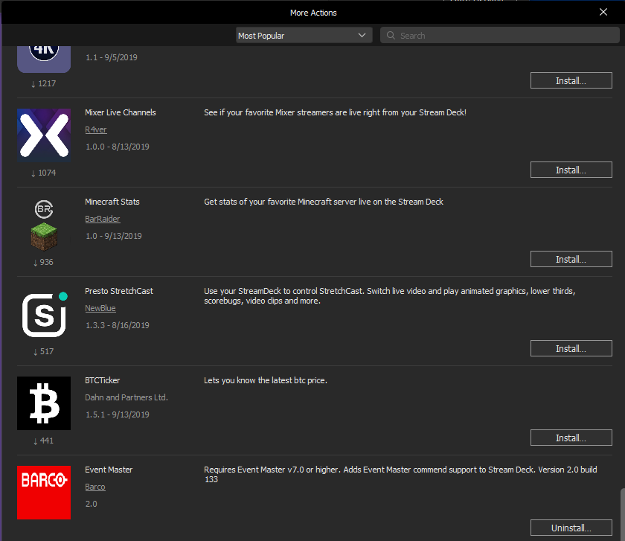
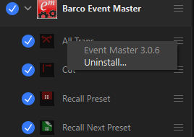
To Upgrade, you must uninstall the existing StreamDeck Event Master plugin
Right-click any action to uninstall

Slide 3
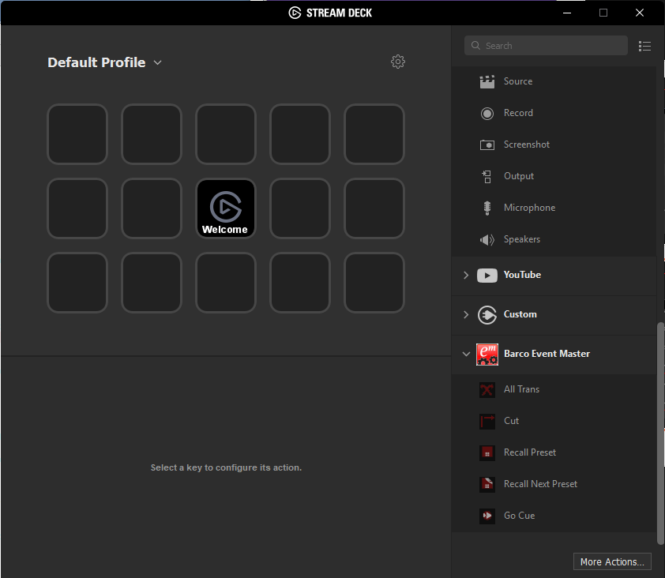
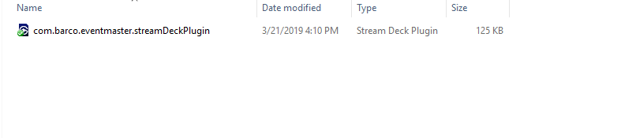
Install the Stream Deck Event Master plugin
Double clicking the plugin will automatically install it
Current version is 3.0
Compatible with Streamdeck v4.9 or greater

Slide 4
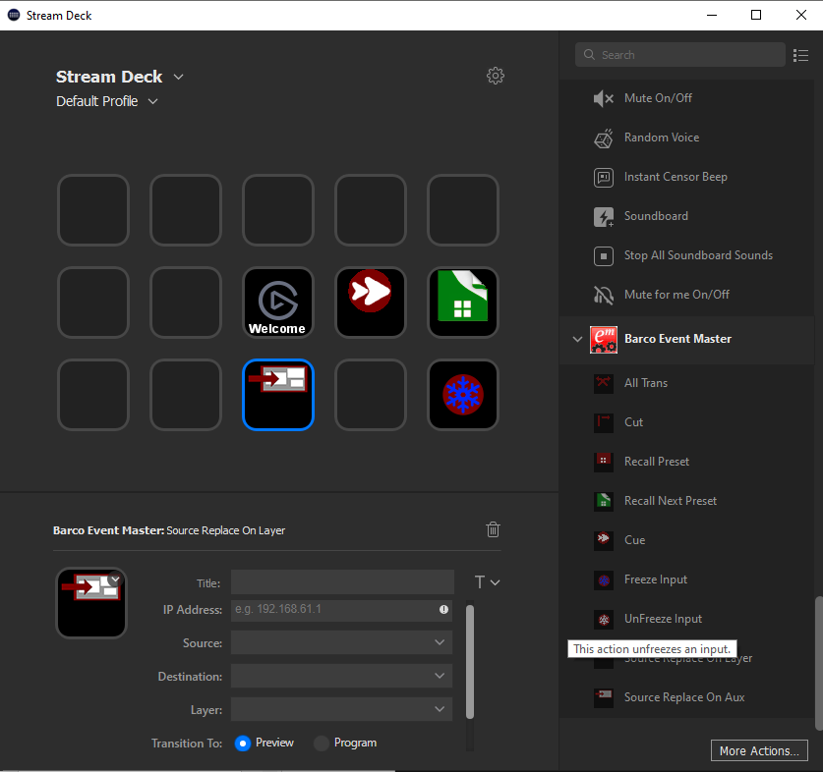
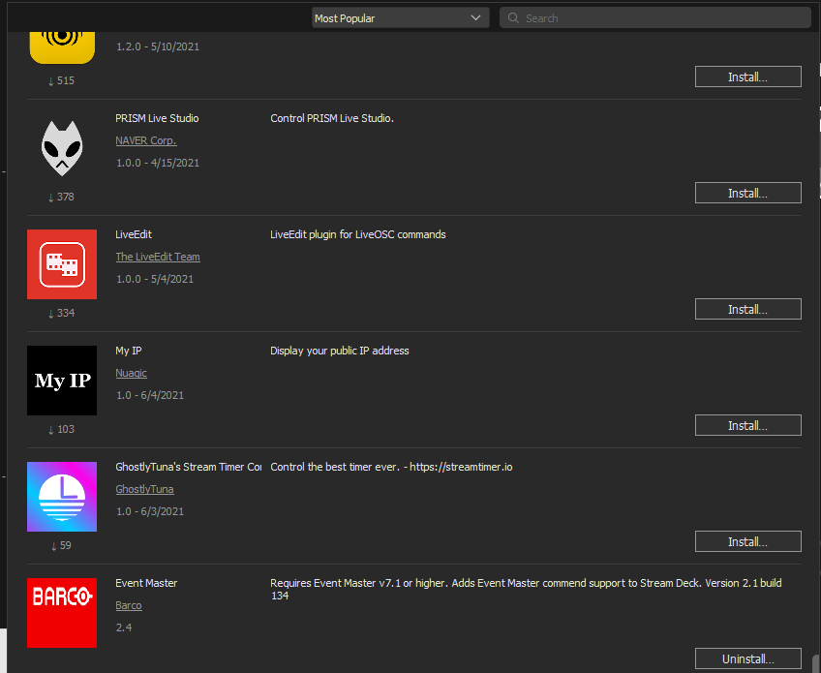
What you should see after installing the plugin

Slide 5
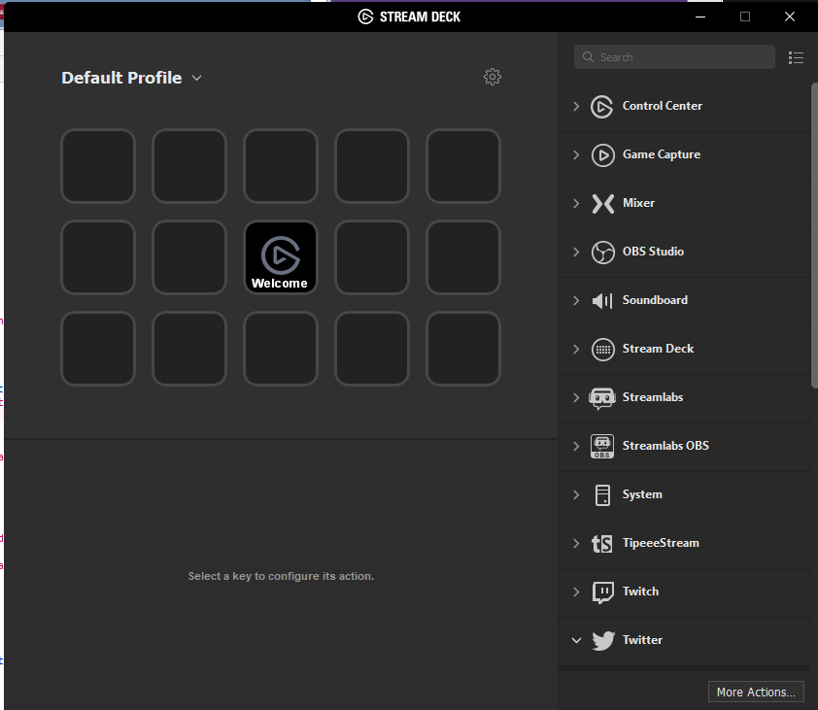
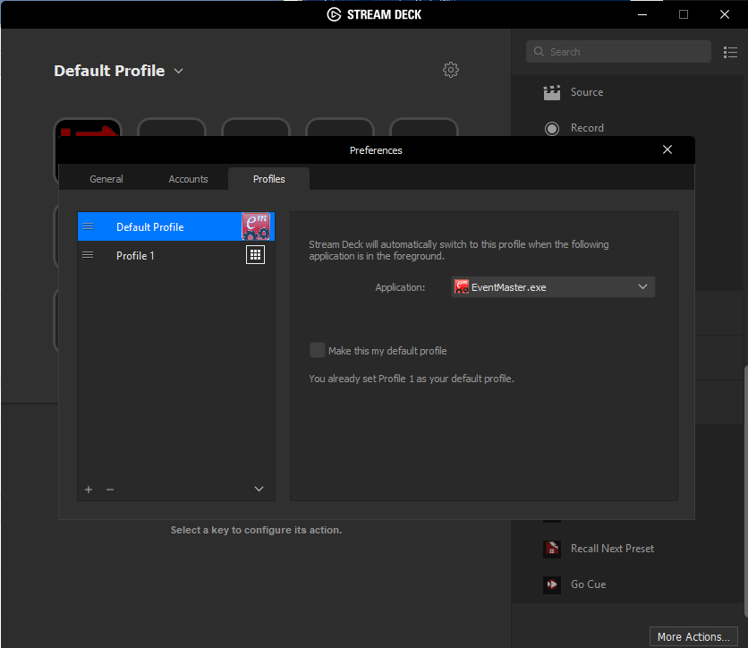
Automatically open EMT
Update profile preferences and select Event Master Toolset

Slide 6
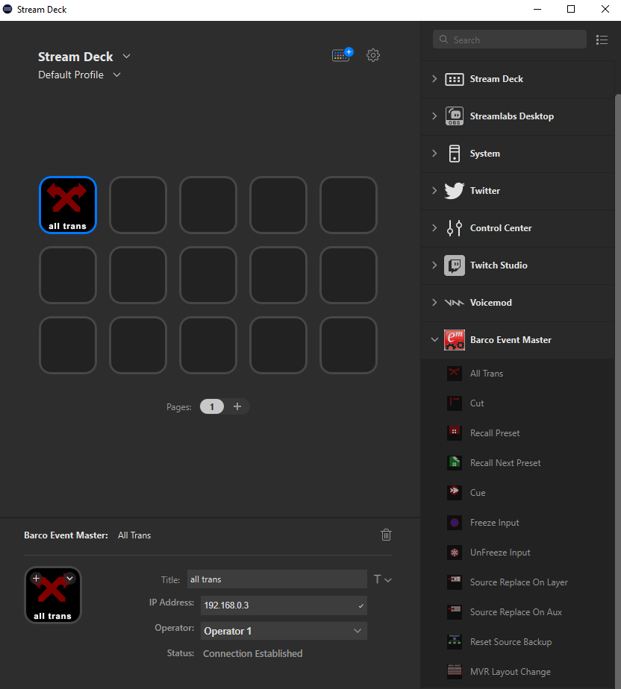
All Trans Action
Drag and drop the action icon to the desired button
Enter:
Button name
EM Ip Address
Select:
Operator
Status will display “Connection Established” if able to connect to Event Master
6

Slide 7
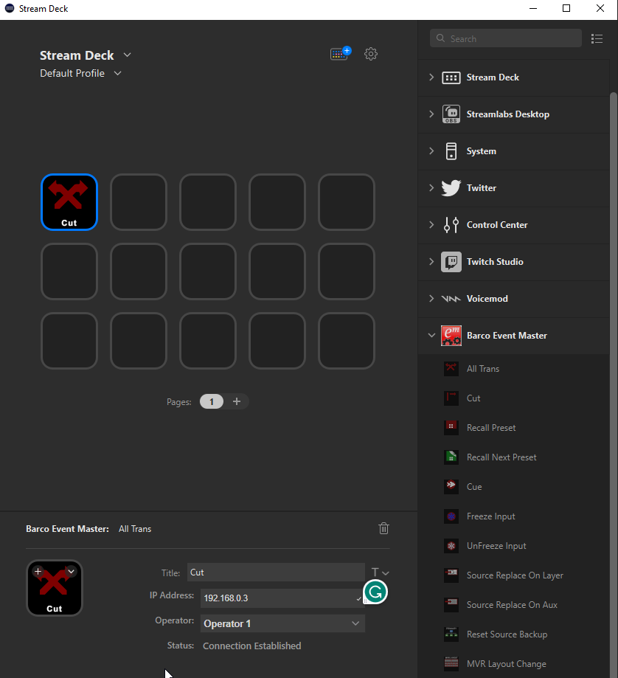
Cut Action
Drag and drop the action icon to the desired button
Enter:
Button name
EM Ip Address
Select:
Operator
Status will display “Connection Established” if able to connect to Event Master

Slide 8
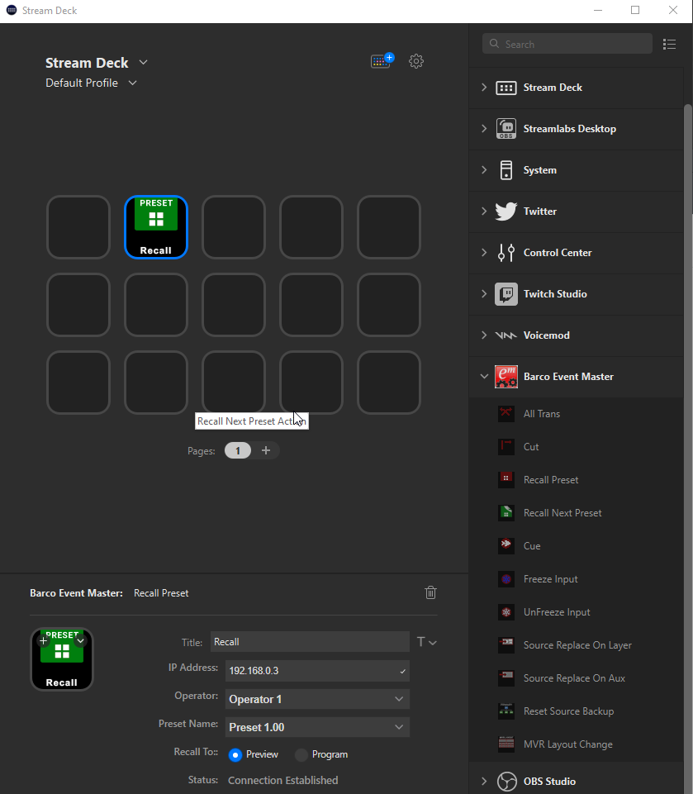
Recall Preset Action
Drag and drop the action icon to the desired button
Enter:
Button Name
IP address
Select:
Operator
Preset Name to recall
Recall to Preview or Program
Status will display “Connection Established” if able to connect to Event Master

Slide 9
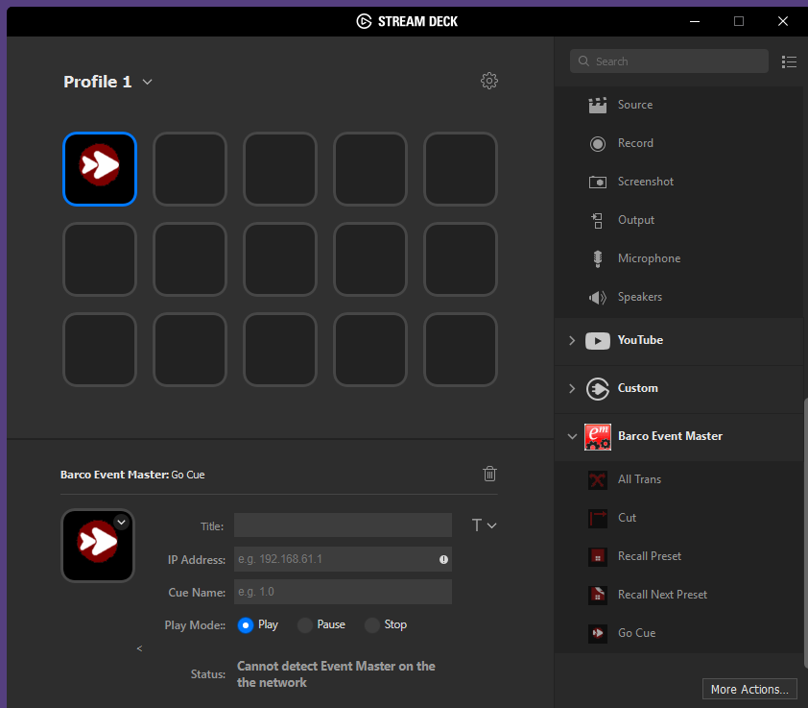
Cue Action
Drag and drop the action icon to the desired button
Enter:
Button Name
IP address
Select
Cue
Cue play mode: Play, Pause or Stop the cue actions
Status will display “Connection Established” if able to connect to Event Master

Slide 10
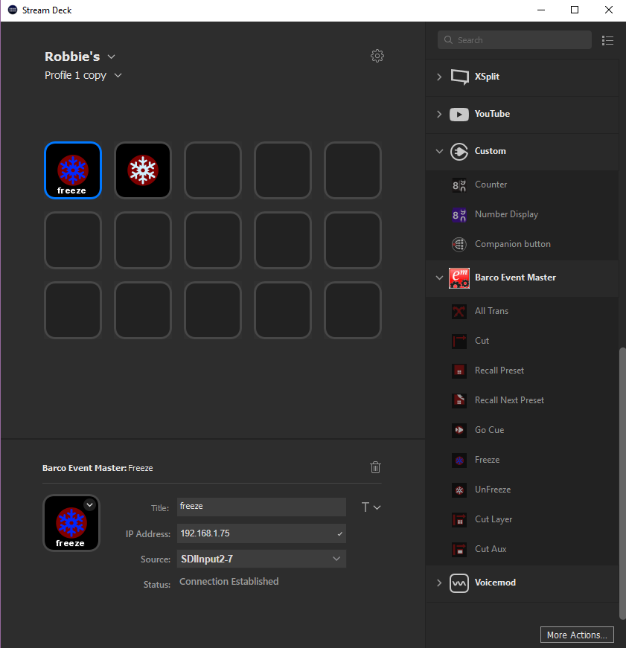
Freeze and UnFreeze Actions
Drag and drop the action icon to the desired button
Action to freeze and unfreeze a given live input or background source
Enter:
Button Name
EM IP address
Select:
Source from the dropdown
Status will display “Connection Established” if able to connect to Event Master
Destination sources are not listed

Slide 11
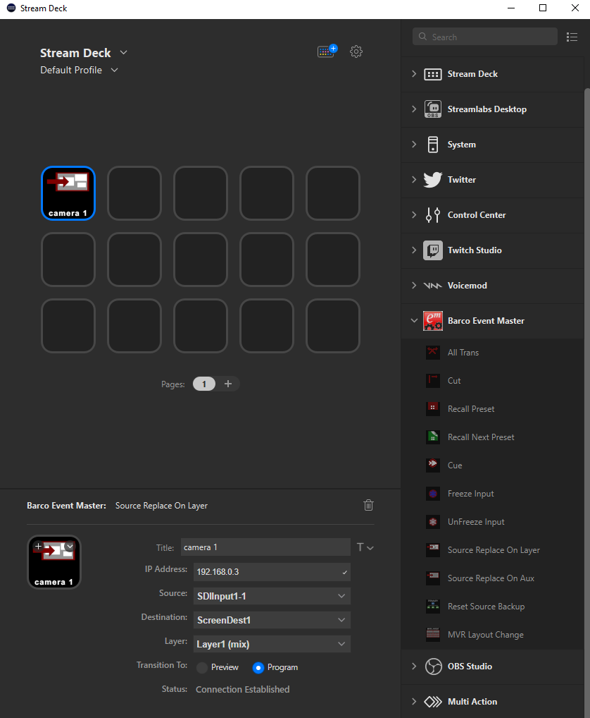
Source Replace on Layer Action
Drag and drop the action icon to the desired button
Action to change a source for a given screen destination and layer
Enter:
Name
IP address
Select:
Operator
Source from the dropdown
Screen Destination from the dropdown
Layer from the dropdown
Status will display “Connection Established” if able to connect to Event Master
If the layer is a mix layer, the action will rely on the Preview or Program selection to determine the appropriate mix layer (A or B)

Slide 12
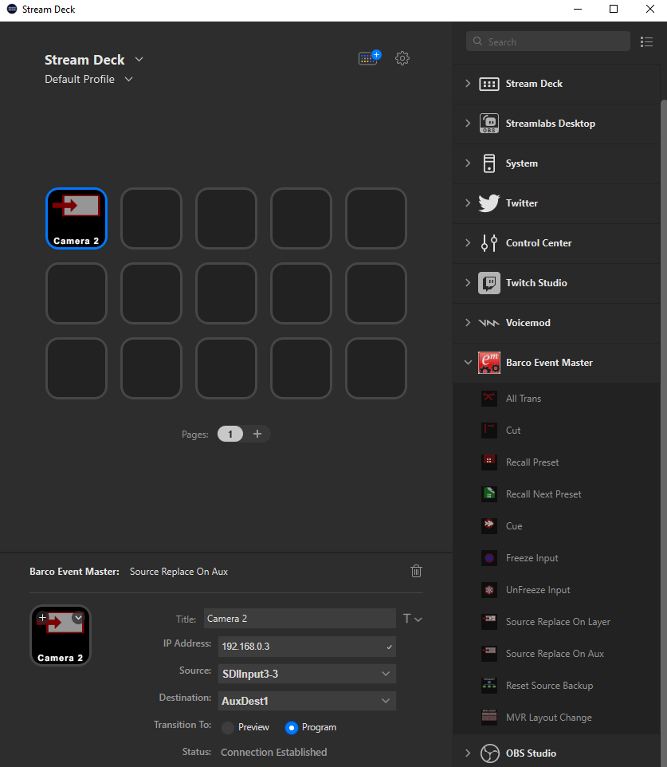
Source Replace on Aux Action
Drag and drop the action icon to the desired button
Action to change a source for a given aux destination
Enter:
Button Name
EM IP Address
Select:
Source from the dropdown
Aux Destination from the dropdown
Status will display “Connection Established” if able to connect to Event Master

Slide 13
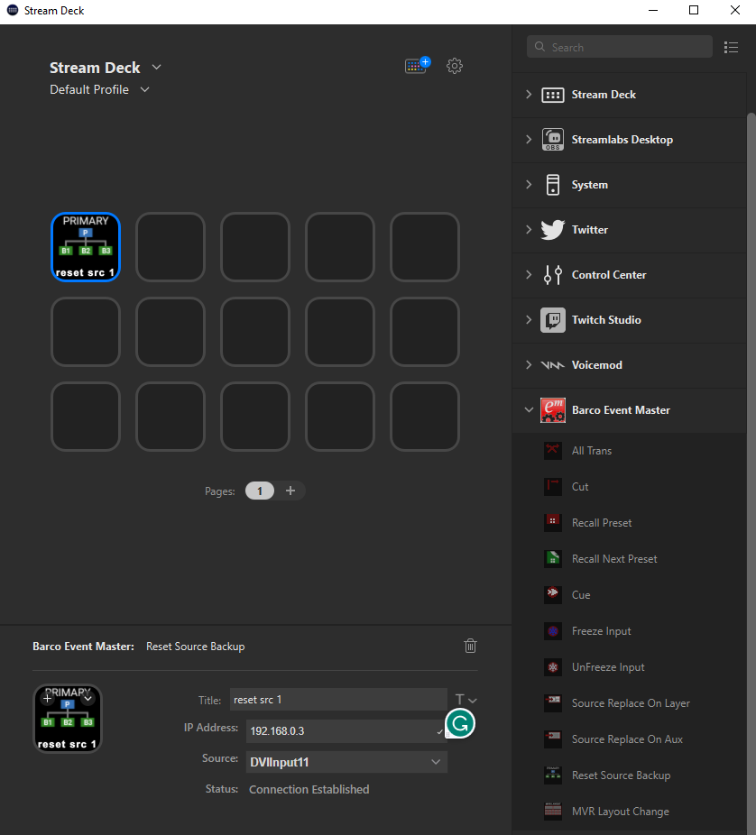
Reset Source Backup
Drag and drop the action icon to the desired button
Action to reset the source backup for a given input source
Enter:
Button Name
EM IP address
Select:
Source from the dropdown
Status will display “Connection Established” if able to connect to Event Master
Destination sources are not listed

Slide 14
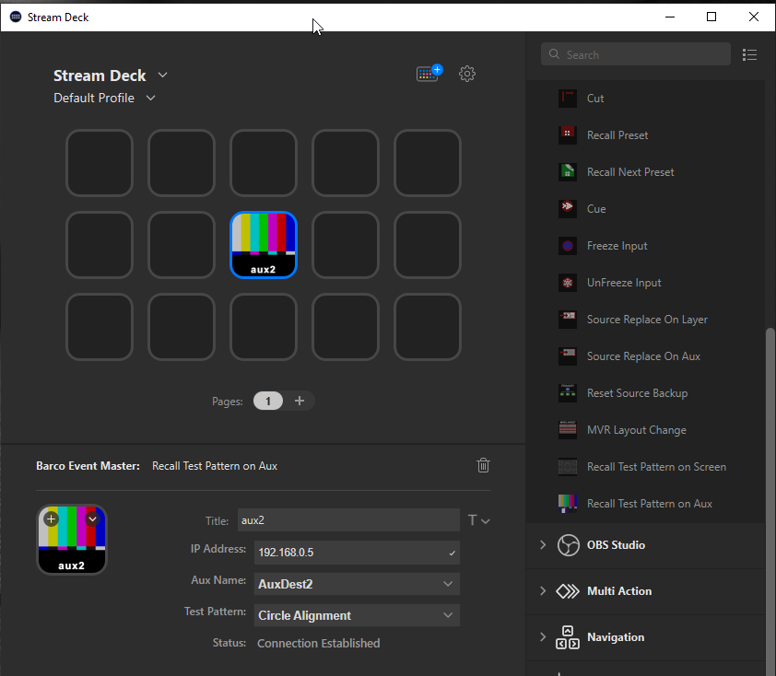
Recall Test Pattern on Aux
Drag and drop the action icon to the desired button
Action to recall a test pattern onto a given aux destination.
Enter:
Button Name
EM IP address
Select:
Aux Destination
Test Patten
Status will display “Connection Established” if able to connect to Event Master

Slide 15
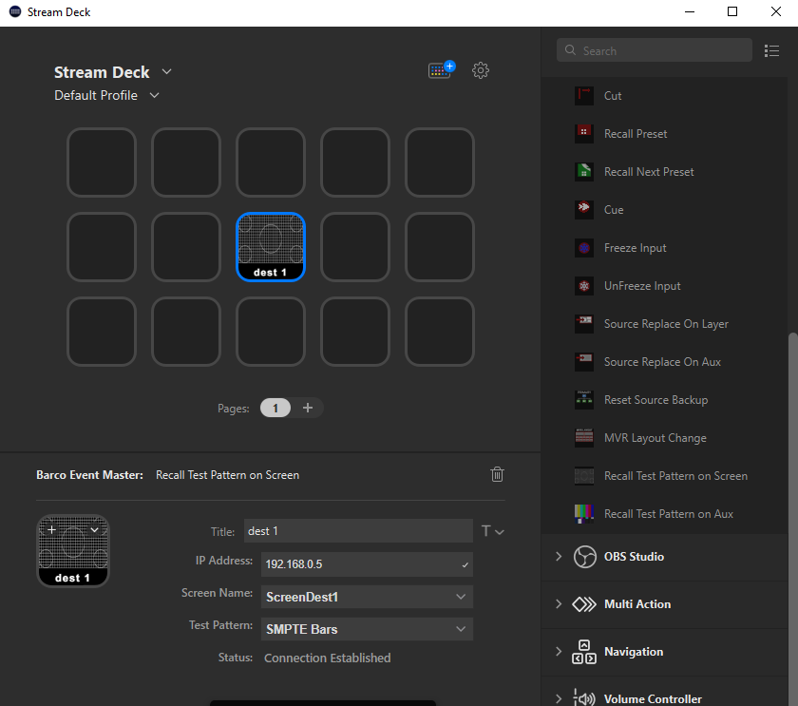
Recall Test Pattern on Screen
Drag and drop the action icon to the desired button
Action to recall a test pattern onto a given screen destination.
Enter:
Button Name
EM IP address
Select:
Screen Destination
Test Patten
Status will display “Connection Established” if able to connect to Event Master

Slide 16
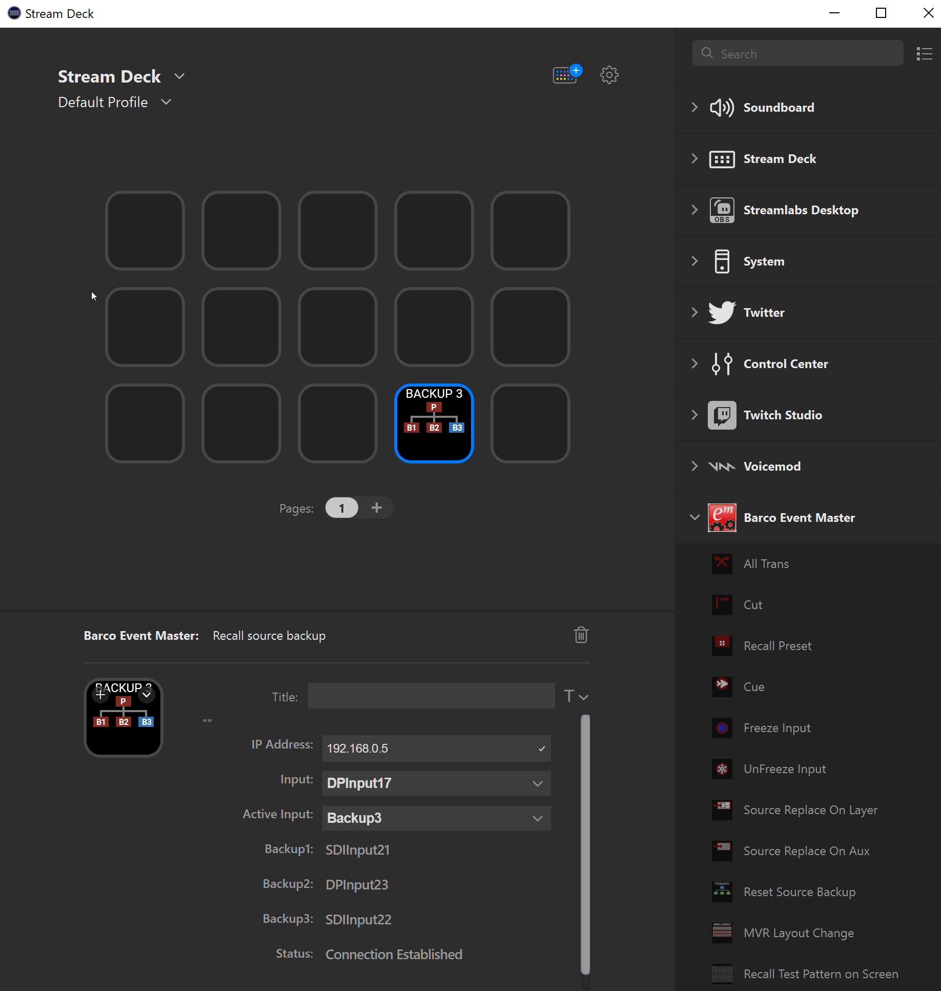
Recall Source Backup
Drag and drop the action icon to the desired button
Action to recall a backup for a given input
Enter:
Button Name
EM IP address
Select:
Input from the dropdown (actual)
Active Input (backup or Primary)
Status will display “Connection Established” if able to connect to Event Master

Slide 17

| youtube.com/BarcoTV
| linkedin.com/company/Barco
| twitter.com/Barco
| facebook.com/Barco
Example of how image can be used – find the right image in the DAM
17

